Slide 1
QUALITY CONTROL IN HOMOEOPATHY

Slide 2
Instructions for quality control given in aphorisms 264 and 265 in sixth edition of Organon of Medicine
Quality control should not only be tested at the end but must be carried out from the moment of receipt of raw material, right through process of manufacturing till the final packaging

Slide 3
Quality Control procedures are
procedures for standardization, by which
the quality of a commodity may be
assessed by ascribing numerical values.
The quality should not only be tested
at the end but must be carried out right
from the moment of receipt of raw
materials, right through processing,
till the final packaging.

Slide 4
OBJECTIVES OF QUALITY CONTROL
The finished product must comply with quality specifications in H.P.I
Contain correct ingredients in the correct proportions
Is of the required purity
Has been correctly manufactured as specified in different pharmacopoeias

Slide 5
Is enclosed in a proper container
Bears the correct label
Is properly stored so that its quality is maintained

Slide 6
STANDARDISATION
Is the process of selecting or making the drug and medicine in uniform standards as mentioned in the Homoeopathic pharmacopoeia. Standardisation is done for
1)Finished products like mother tinctures, triturations and dilutions
2)Raw materials like plant, animal and chemical sources
3)Vehicles
4)Packing and labeling materials

Slide 7
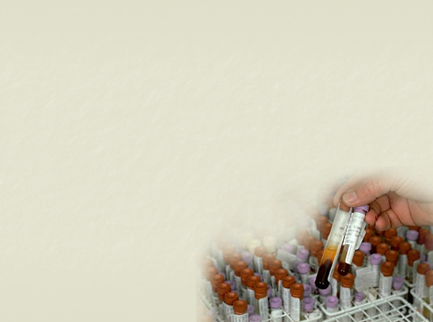
Quality Control includes analytical
testing of finished product and also
assessment of all operations beginning
with receipt of raw materials and
continuing throughout the production
and packaging operations, finished
product testing, documentation,
surveillance and distribution.

Slide 8
STANDARDIZATION OF HOMOEOPATHIC PRODUCTS
In India, Drugs and Cosmetics Act 1940
controls quality of homoeopathic
medicines.
The Homoeopathic Pharmacopoeia
Laboratory (HPL) was established in 1975
under the Ministry of Health and Family
Welfare, Government of India as a quality
monitoring apex body. Main function is to set standards and drug testing at national level

Slide 9
Worked out standards are released in
form of Homoeopathic Pharmacopoeia
of India (HPI).
The problems of quality control with
homoeopathic potencies serve one of
the areas of greatest challenge.

Slide 10
The extremely high dilutions of
homoeopathic potencies make it almost
impossible to apply analytical tests by
conventional methods in the laboratory.
Only mother tinctures, apart form the
raw material are subjected to a
comprehensive analysis,
both qualitative and quantitative.

Slide 11
PARAMETERS FOR QUALITY CONTROL
MATERIALS TO BE STANDARDISED
Raw materials
Finished products
Packaging materials – containers, cartons, labels
Vehicles

Slide 12
MEN
Persons involved in manufacturing and packing the product has significant role in quality of medicines
Attitudes, motivation and desire of men working in manufacturing unit is not proper the quality of medicines tend to be doubtful.
Reliability of the product depend upon the sincerity of the staff as the homoeopathic medicines are difficult to evaluate

Slide 13
EQUIPMENTS
Must be accurate and capable of reproducing quality
ENVIRONMENT
Under which raw materials are stored, manufactured and packed must be hygienic
Contamination with pollutants may deteriorate the quality of products

Slide 14
METHODS
Methods employed for the manufacture of homoeopathic medicines must be in conformation to Hahnemannian standard
Increased demand of medicines have resulted in introduction of modified techniques of preparation
Hahnemann’s original procedures should be followed as far as possible
Pharmacopoeial guidelines for identification, collection, preservation, preparation and analysis must be followed

Slide 15
INFRASTRUCTURE
Should be constructed as per GMP (Good Manufacturing Practices) Rules

Slide 16
QUALITY CONTROL SECTIONS
RAW MATERIAL AND VEHICLES
IN PROCESS QUALITY CONTROL
Includes every step of the preparation of medicines from raw materials to finished products
FINISHED PRODUCTS
STORAGING AND PACKAGING

Slide 17
STANDARDS FOR QUALITY CONTR0L
PHYSICAL STANDARD
1) Estimation of physical standards like
BP, MP, PH, Refractive index, Optical rotation
2) Noting the external morphological appearance of the drug substance like size, shape, odour, taste, colour

Slide 18
CHEMICAL STANDARD
Quantitative estimation of chemical constituents in drug
Impurities present in drug substance
Limit test for arsenic, lead, sulphur
Absence of adulterants in vehicles like SL, Oils
Determination of acid value, iodine value, ester value
Quantitative determination of alcohol content in mother tincture and dilutions

Slide 19
BIOLOGICAL STANDARD
Estimation of effect of the drug or it’s different constituents on living organism
The extent of neutralising or preventing action of the medicine against the specific activity of bacteria or other toxins
Effect of drug on organs like heart, kidney, uterus, muscles, sugar metabolism, changes in blood

Slide 20
METHODS OF EVALUATION
ORGANOLEPTIC EVALUATION
MICROSCOPIC EVALUATION
PHYSICAL EVALUATION
CHEMICAL EVALUATION
BIOLOGICAL EVALUATION

Slide 21
ORGANOLEPTIC EVALUATION
Evaluation of drug substance by means of sense organs like eyes, tongue, nose and skin. It includes macroscopic appearance, odour, taste, external morphological appearance and feel of drug to touch. Evaluation method includes
1)Determination of shape and size of drug
Aconite – conical
Allium cepa – bulb
Zingiber officinalis – rhizome with nodes

Slide 22
2)External colour of the drug substance
May be white, yellow, brown, red, orange or brownish black. Standardised according to instructions of inter-society colour council
3)External markings like furrows, wrinkles, ridges
4)Fractures – To study the way how the plant breaks when subjected to pressure
5)Odour – camphora, asafoetida, curcuma longa, naphthelene, nut meg

Slide 23
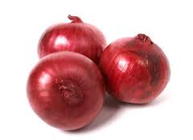
ALLIUM CEPA BULB

Slide 24
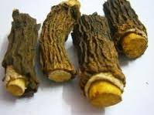
SARSAPARILLA

Slide 25
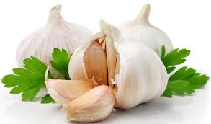
ALLIUM SATIVUM

Slide 26
ACONITUM NAPELUS

Slide 27
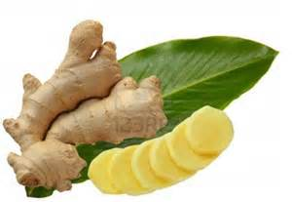
ZINGEBER OFFICINALIS

Slide 28
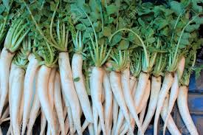
RAPHANUS SATIVUS

Slide 29
MICROSCOPIC EVALUATION
Helps to find out adulterants in powdered plant and animal drugs
Microscopic appearance of drug in sectional view as well as powdered form is given in the monograph of respective drug in pharmacopoeia.
Plant parts are made up of tissues. Histology helps to study the arrangement and individual character of these tissues

Slide 30
Powdered drugs Gives very few microscopic features for identification because normal histology is lost. Powder should be reduced to No 40 size. Plant cells are mostly broken. Cell contents like calcium oxalate, starch, aleurone, oil remain scattered in powder
Study of stomatal index help to identify the plant

Slide 31
MICROCHEMISTRY
Includes the study of constituents of drugs by chemical methods
A few mg of the powdered drug or histological section of drug is used for chemical analysis
Analytical test include
1)Isolation of constituents of drugs by
A)Microsublimation- Small quantity of drug substance subjected to vapourisation and condensation. Crystals are obtained and identified by crystallography

Slide 32
B)Using chemical solvents to dissolve constituents
2)Identification of chemical constituents by
A)Crystallography
B)Determination of melting point
C)Colour reaction test

Slide 33
PHYSICAL EVALUATION
Chromatography
Flourescence Test – Mother tincture is exposed to UV rays. Eg : Rheum – violet colour, Rouwalfia – blue colour
To find out physical constants like MP, BP, Refractive index, Optical rotation

Slide 34
CHEMICAL EVALUATION
Determination of values like ester value, saponification value, acid value
Quantitavive estimation of chemical constituents in drugs
Limit tests for arsenic, phosphorus, lead, iron
Determination of adulterants in raw materials and vehicles
Quantitative determination of alcohol content of mother tincture and homoeopathic dilutions

Slide 35
BIOLOGICAL EVALUATION
Is evaluated by drug proving
Is done to know the sphere of action of drugs
To know the pharmacodynamic action of drug
Action against micro organisms
To know about the functional and structural changes caused by the drug in healthy organisms

Slide 36
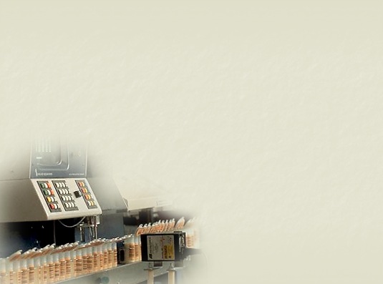
SAMPLING
Sampling of raw materials
is a very significant step in
the overall quality control.
The attribute is based
on the sample taken
and if the sample is not
a true representative of
the 'whole' the entire
process can go astray.

Slide 37
Scientifically a true and ideal sample
should consist of appropriate number /
quantity from a batch which will reflect
the true nature of the entire mass.

Slide 38
METHOD OF OFFICIAL SAMPLING
It is recommended that gross sample of
vegetable drugs in which the component
parts are over 1cm in any dimension, be
taken by hand.
When total weight of drug to be sampled is
less than 100 kg and more than 1 cm, at least
500g constitutes an Official Sample, and shall
be taken from different parts of container or
containers. If less than 1 cm – 250 g.

Slide 39
When total weight of drug to be sampled is in excess of 100 kg and more than 1 cm, several samples shall be taken by means of a sampler that removes a core from top to the bottom of the container, and mixed and quartered, two of the diagonal quarters being rejected, and the remaining two quarters being combined and carefully mixed and again subjected to a quartering process in the same manner until two of the quarters weigh not less than 500 g which later quarters shall constitute an Official Sample. If less than 1 cm – 250 g.

Slide 40
When the total weight of the drug
to be sampled is less than 10 kg,
it is recommended that the above
described method be followed,
but that somewhat smaller quantities
be withdrawn and in no case shall
the final Official Sample weigh less
than 125 g.

